Slide 1

Exploring end-to-end principles for Democratization of AI/ML
Sharmistha Chatterjee
Senior Manager Data Sciences, Publicis Sapient
GDE Machine Learning, Google Cloud
https://techairesearch.com/
Sharmistha Chatterjee, GDE

Slide 2
Agenda
Why Data Democratization?
Google Technologies in Data and AI/ML Democratization
Explainability and Ethics in Data Democratization
Case Study in AI Democratization
Sustainability in AI Democratization

Slide 3
Why Data democratization?

Slide 4
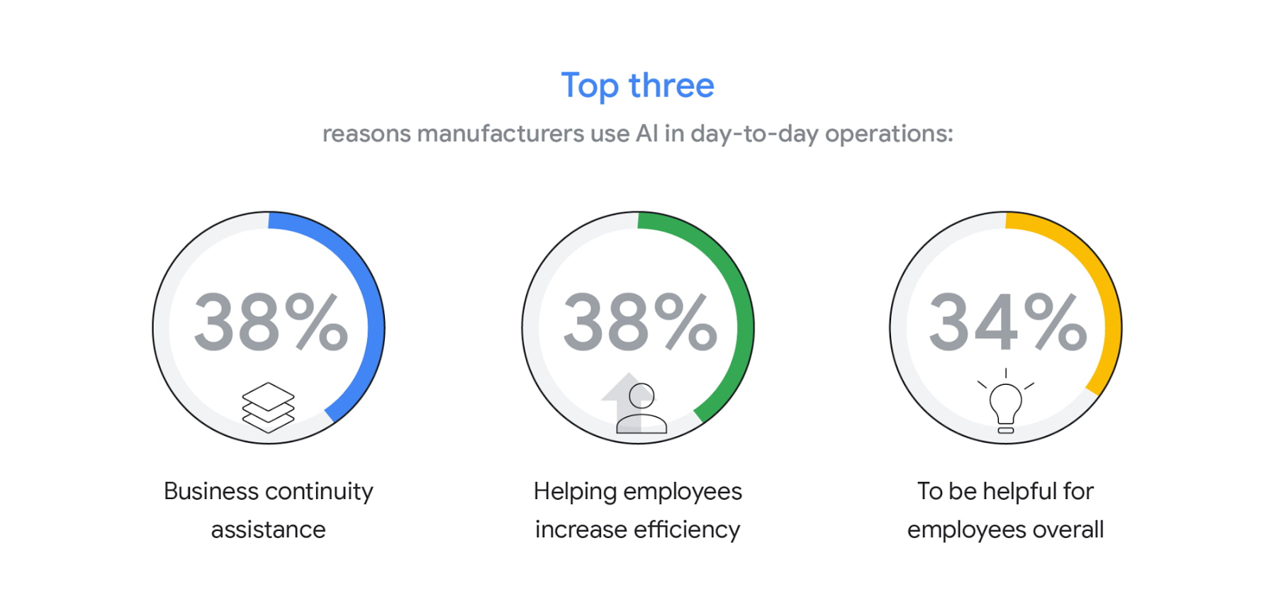
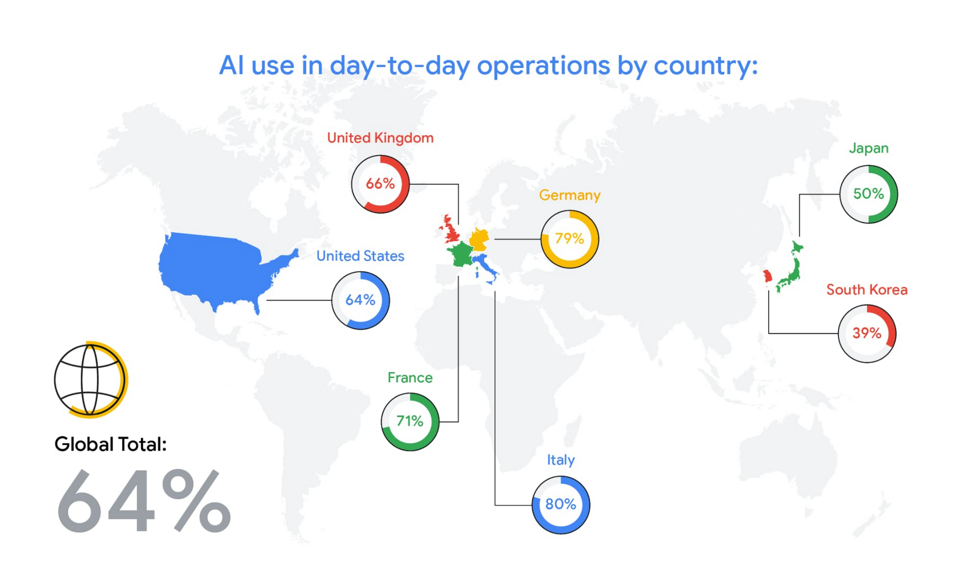
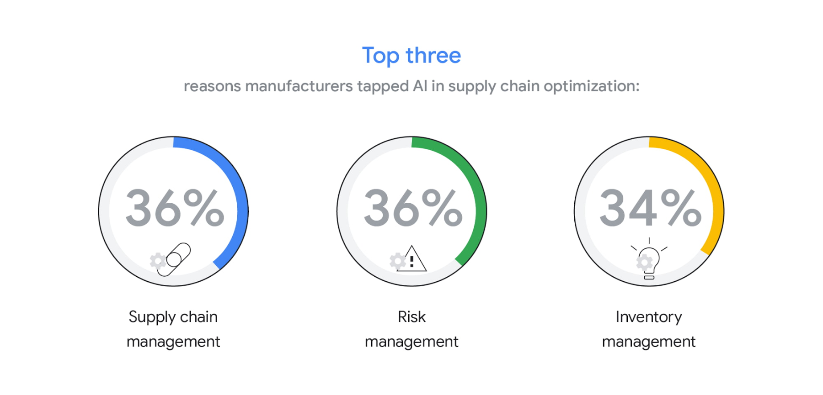
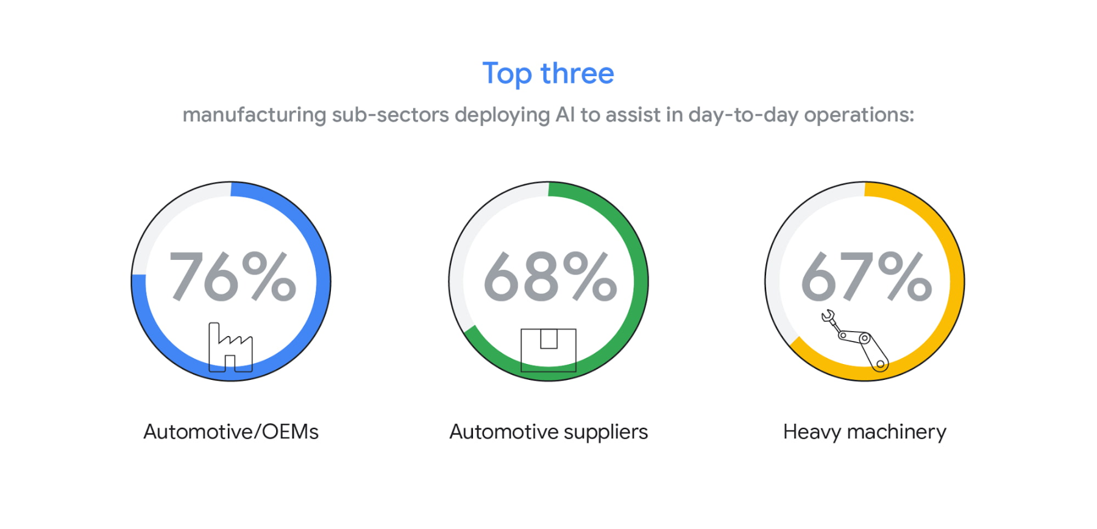
AI Adoption worldwide
How Manufacturing Operations depend on AI/ML
Challenges
Talent
Right Technology Platform to manage production pipeline
Source :https://cloud.google.com/blog/products/ai-machine-learning/research-on-ai-trends-in-manufacturing

Slide 5
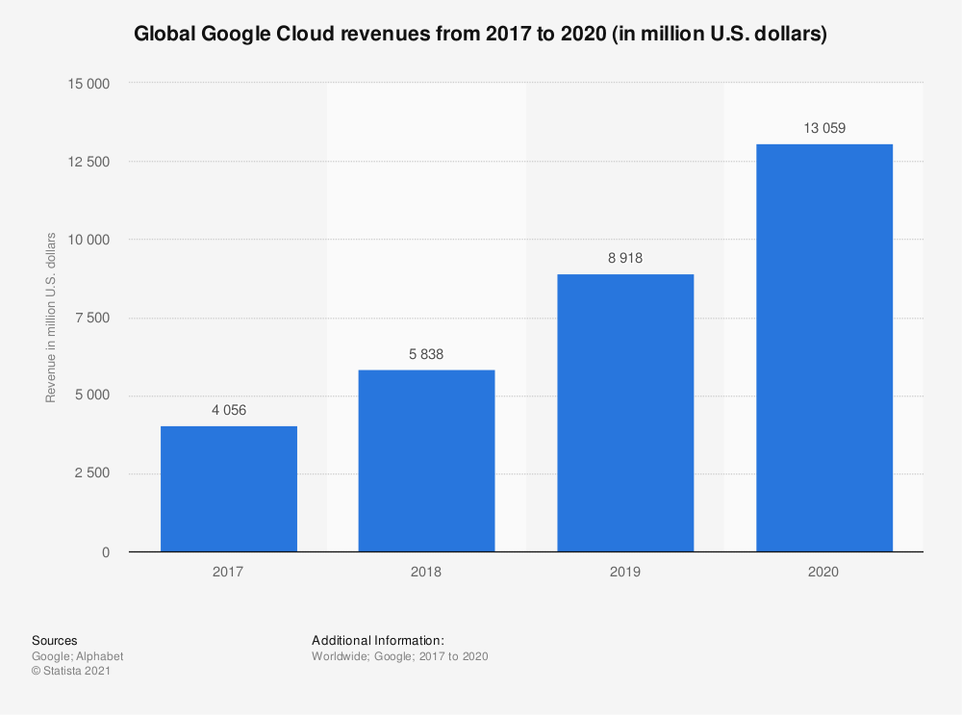
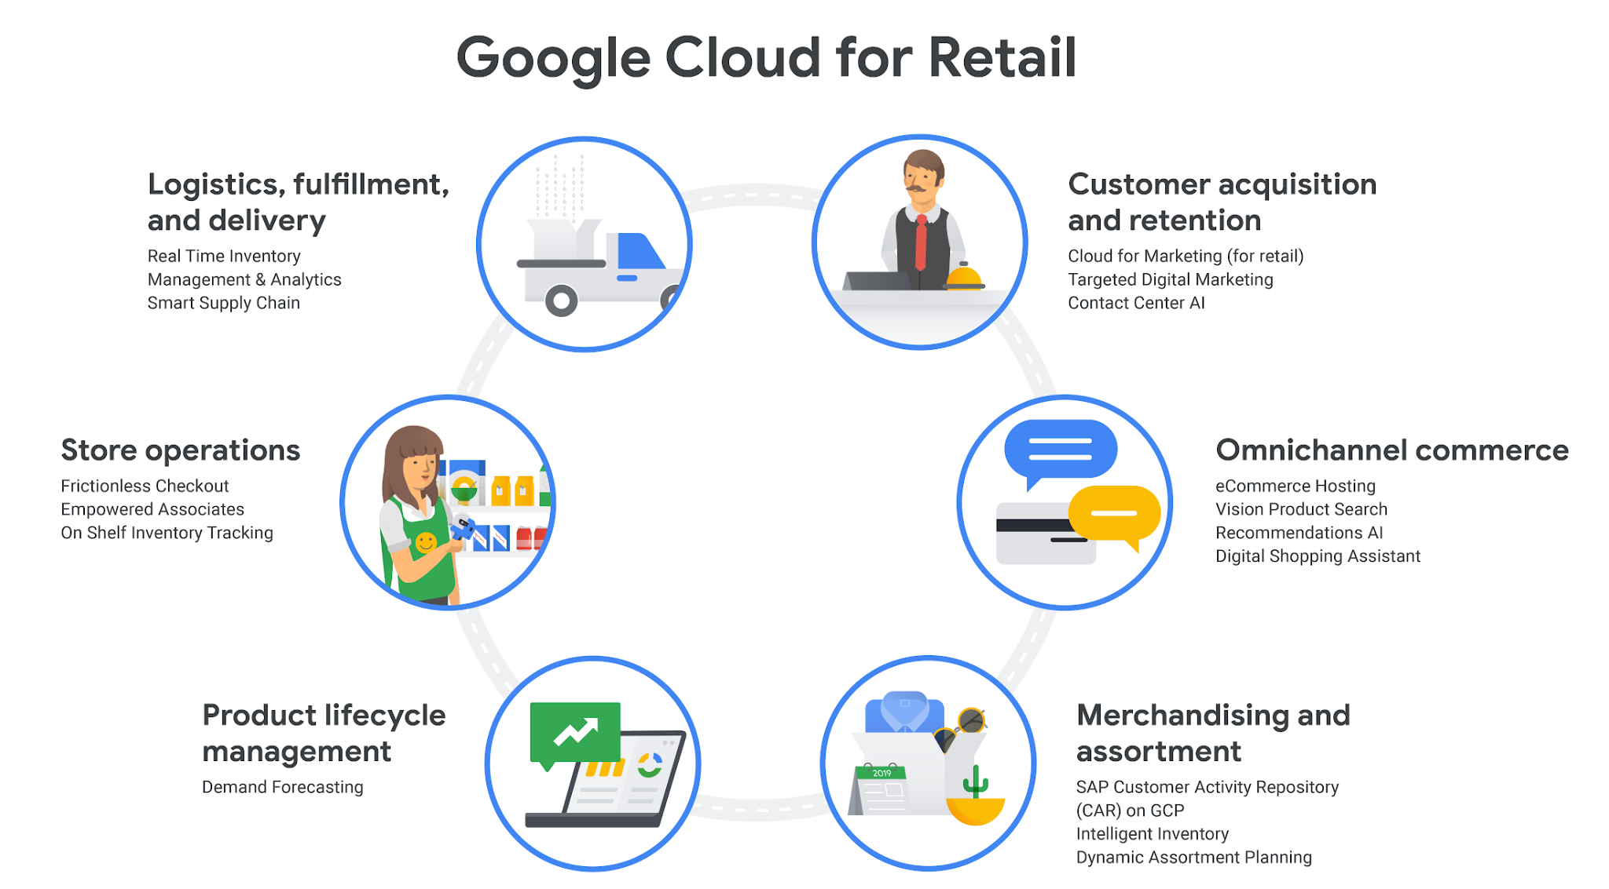
Personalized AI Solutions with Google Cloud
Business Impact
Flexible Deployment
ML Model Life-cycle Management
Reduced time in data preparation
Collaboration
Source - Statista
Source - https://cloud.google.com/blog/topics/retail/google-cloud-for-retail-helping-retailers-transform-their-businesses

Slide 6
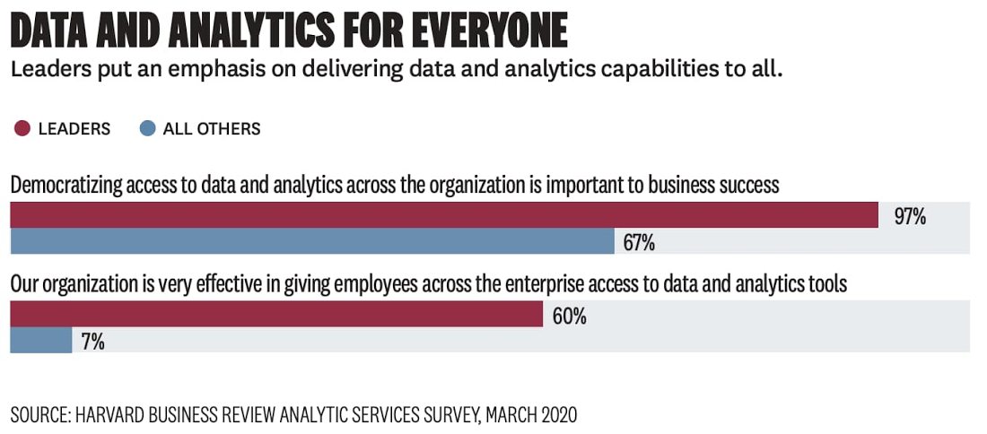
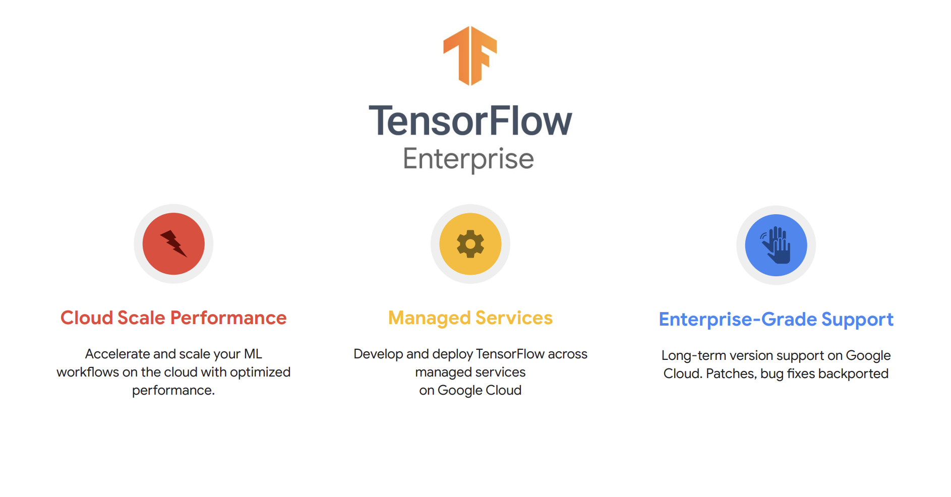
Journey to AI/ML Democratization
Rapid Iteration and efficient development
Tensorflow Enterprise to support scalable Tensorflow in the cloud
Democratize ML across data analysts, developers and data engineers
Source : https://cloud.google.com/blog/products/data-analytics/democratizing-data-and-insights-with-google-cloud

Slide 7
Google Technologies in Data & AI/ML democratization

Slide 8






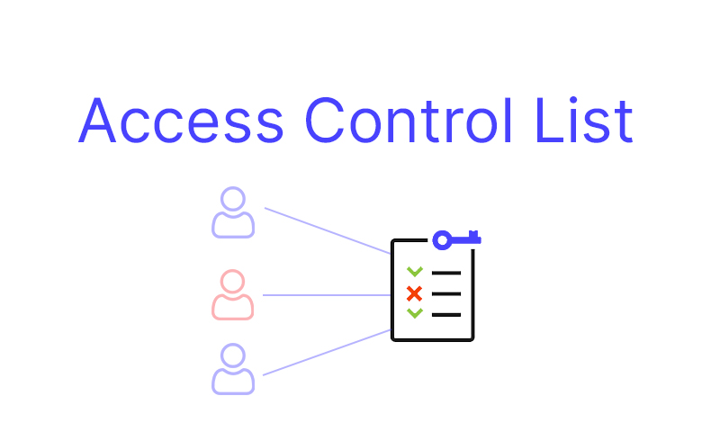




Data Democratization Principles
Data Accounting
Data Silo Directory
Data & Model Governance
Data & Model Management
Middleware Strategy
Data Accessibility
Data Source Mapping
Pub-sub
Dataflow
AdaNet
Data DLP
Data Catalog
Big Query
Data Fusion
Speed
Access
Purpose
Competitiveness
Agility
Vertex AI
Data DLP
Cloud IAM
Cloud AutoML
Source : https://www.dataservicesinc.com/newsletter/data-democratization-strategy-guide/

Slide 9
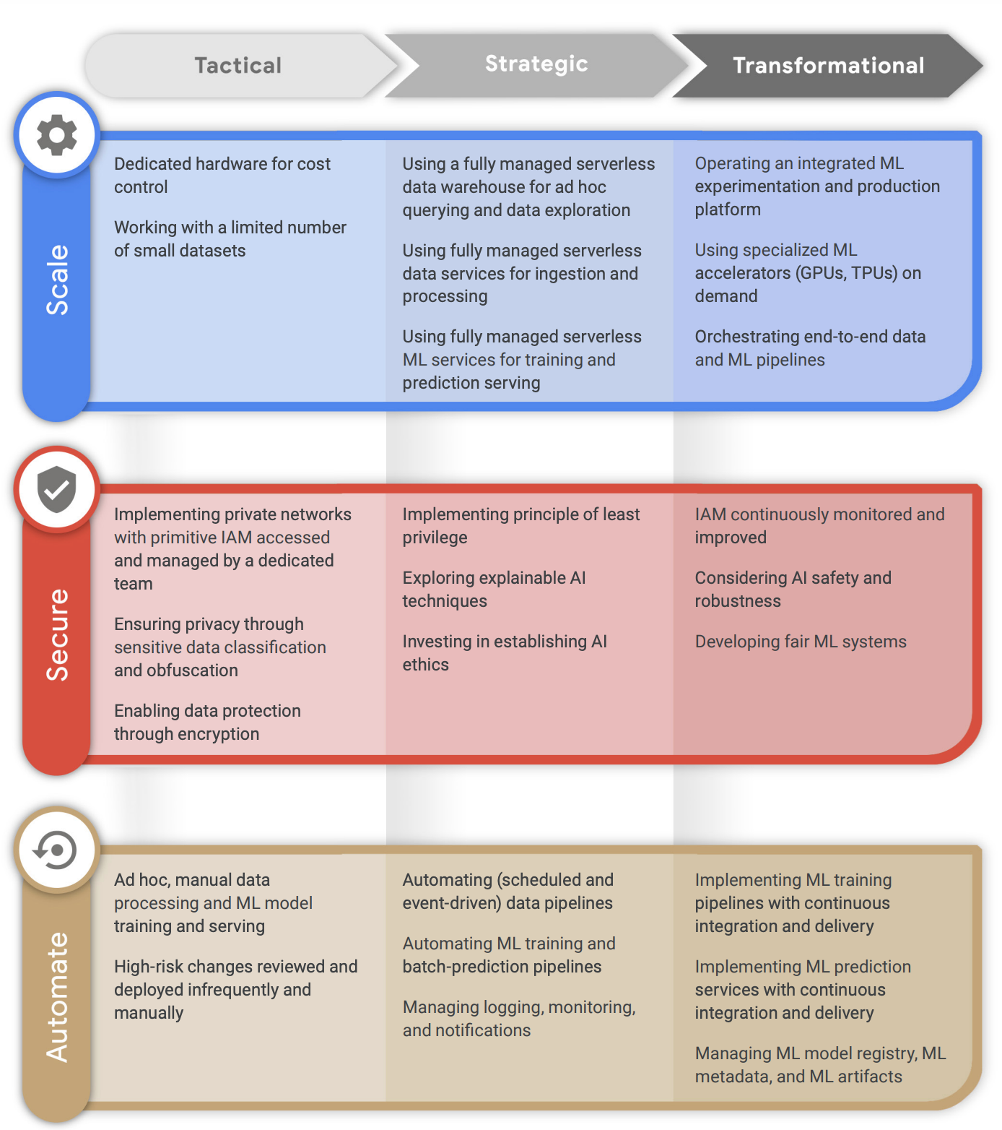
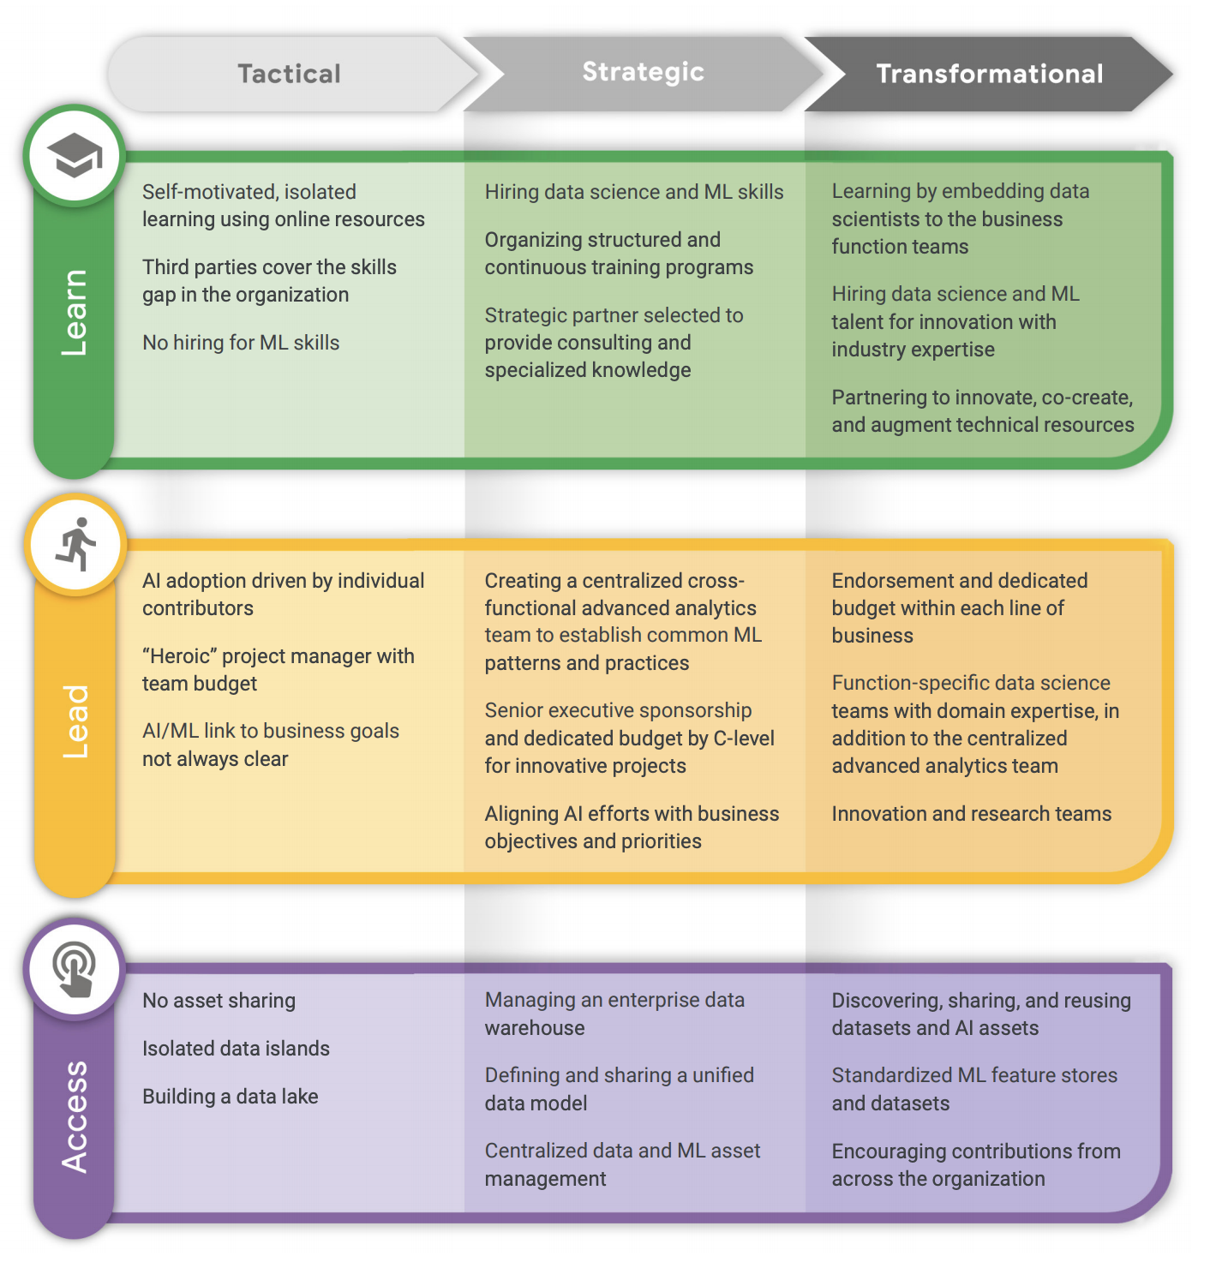
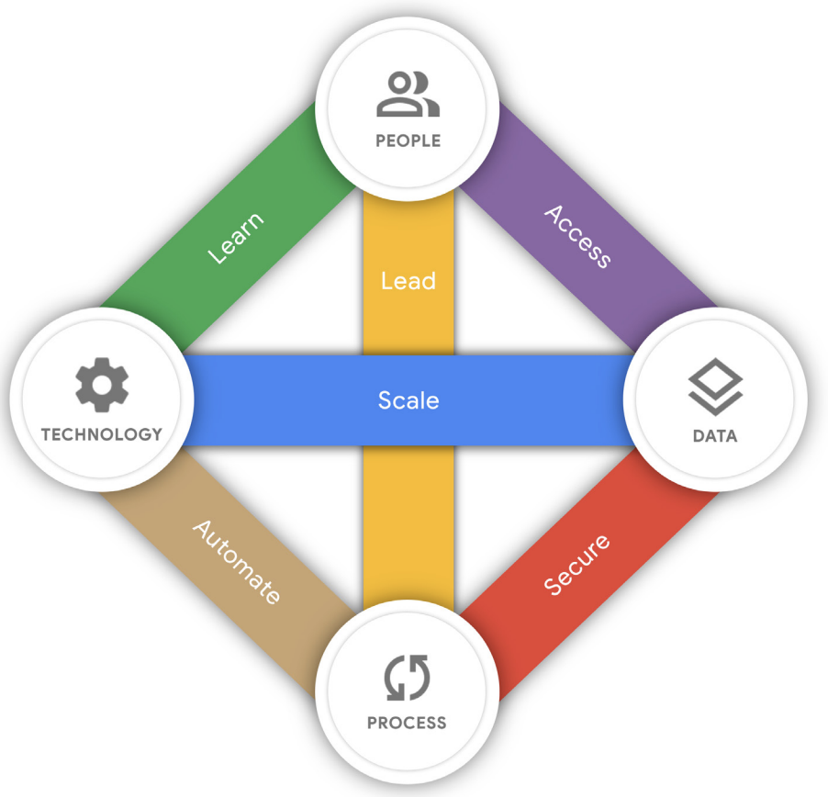
AI Democratization Frameworks
AI Maturity
Source - https://services.google.com/fh/files/misc/ai_adoption_framework_whitepaper.pdf

Slide 10

Cloud AI Platform - A Snapshot
Ingestion
Analysis
Transform
Training
Tracking
Evaluating
Deployment
Monitoring
Models
Evaluation
Endpoints and Batch Predictions
AutoML
Managed dataset
Labeling Tasks
Custom code
Specific ML problem with required schema
Unmanaged data
BigQuery, GCS, Spanner , BigTable
Trained outside Cloud AI
Source: Google

Slide 11
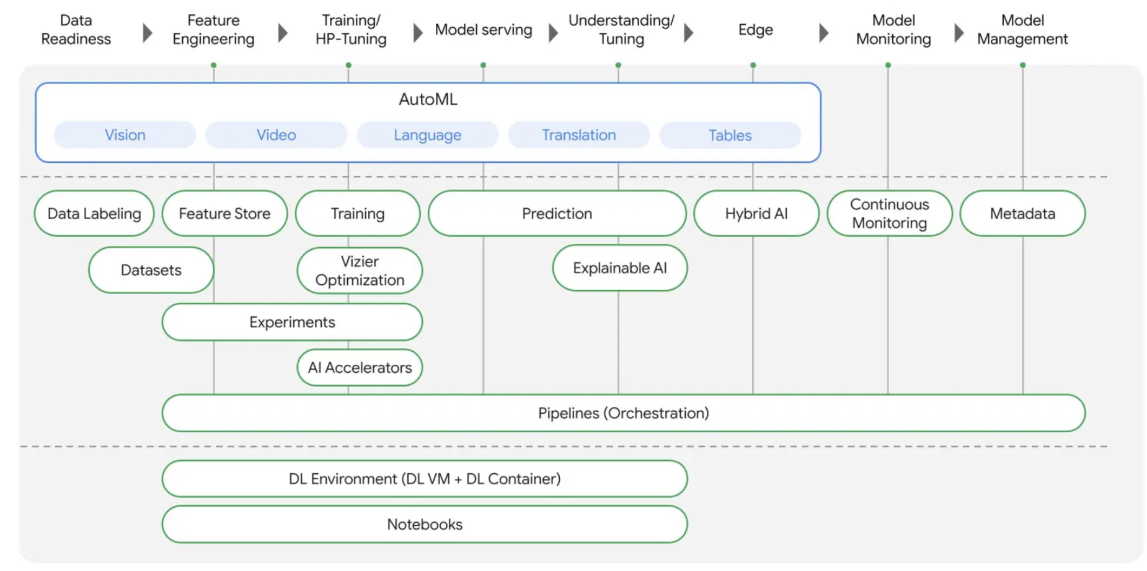
Model Management Platform Vertex -AI
AutoML
Feature Store
Hyper-parameter Tuning
Automated A/B testing
Model Deployment
Source: Google, https://storage.googleapis.com/pub-tools-public-publication-data/pdf/bcb15507f4b52991a0783013df4222240e942381.pdf

Slide 12
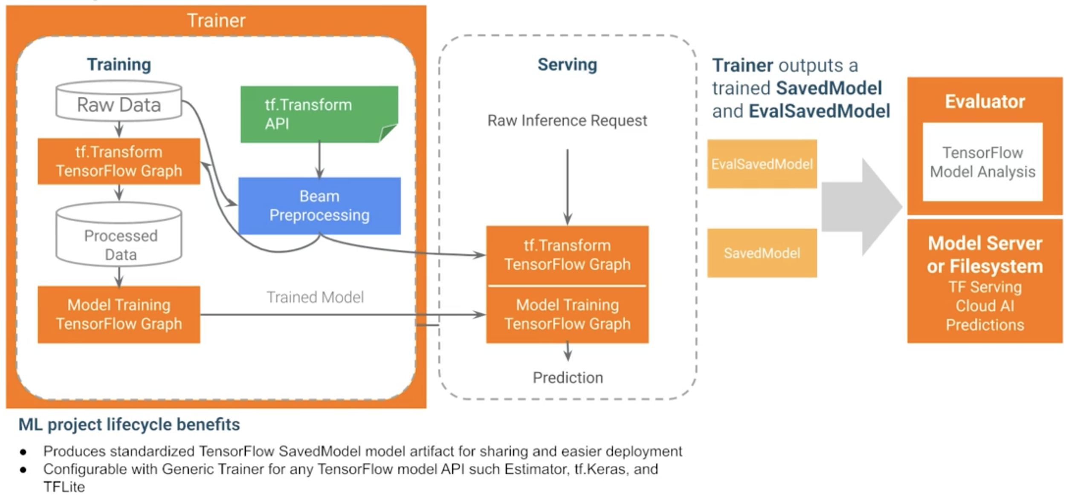
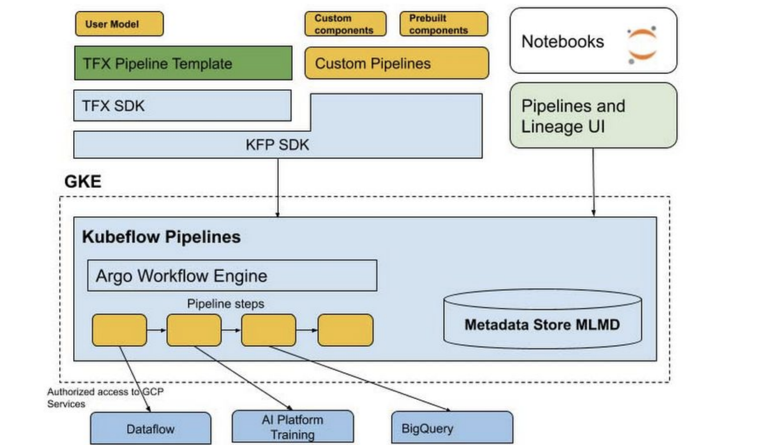
Data processing, training and model serving with Tensorflow
Orchestration
Apache Airflow
Apache Beam
Kubeflow Pipelines
tensorflow_model_server --port=8500 --rest_api_port=8501
--model_config_file=/path/to/models.config
Source: https://www.coursera.org/learn/ml-pipelines-google-cloud/lecture/3SsWF/tfx-standard-model-components, https://towardsdatascience.com/scaling-machine-learning-models-using-tensorflow-serving-kubernetes-ed00d448c917, Google

Slide 13
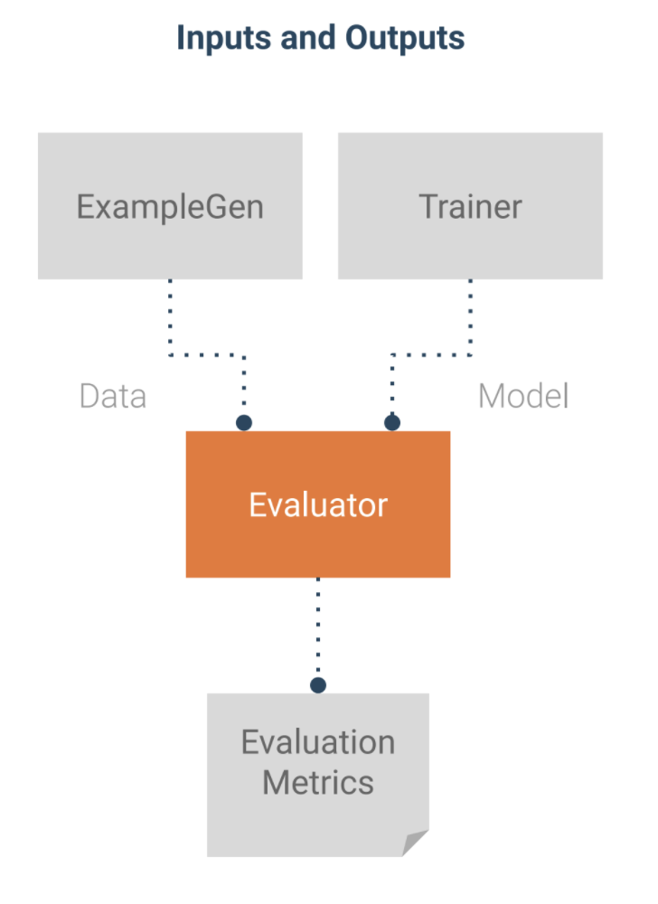
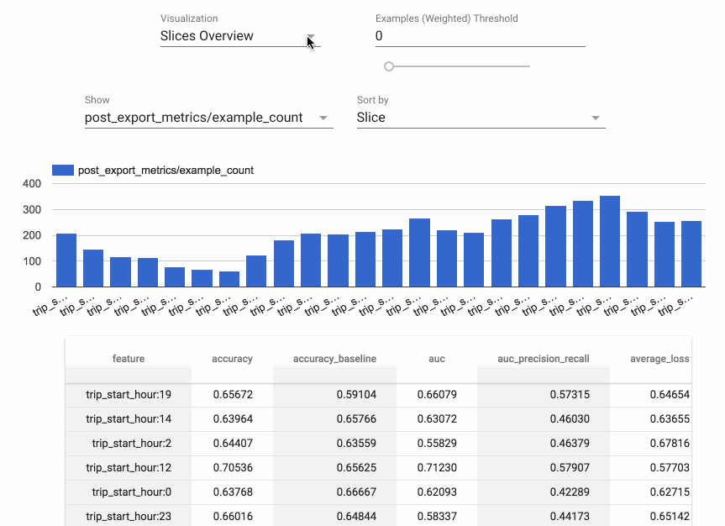
Major Standard TFX component: Evaluator (feat. TFMA)
Source: https://www.coursera.org/learn/ml-pipelines-google-cloud/lecture/3SsWF/tfx-standard-model-components

Slide 14
Explainability and Ethics in AI Democratization

Slide 15
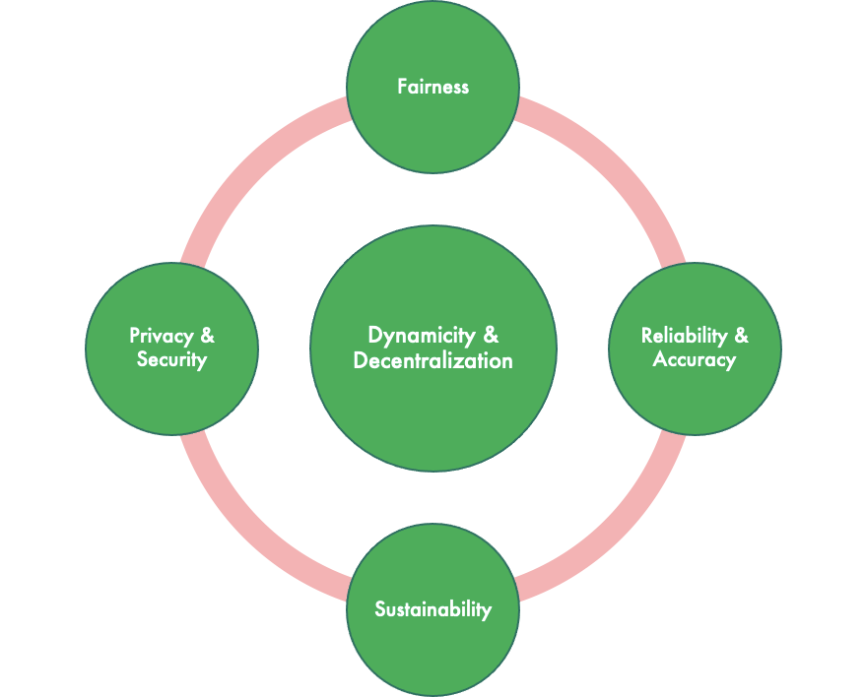
Key pointers to AI/ML Democratization
Objectives
Handle climate changes
Remove bias to avoid unfair targeting
Develop standards to narrow gender,race gaps
Increased trust & transparency
Speed & Agility
Source : https://cloud.google.com/blog/products/data-analytics/democratizing-data-and-insights-with-google-cloud

Slide 16
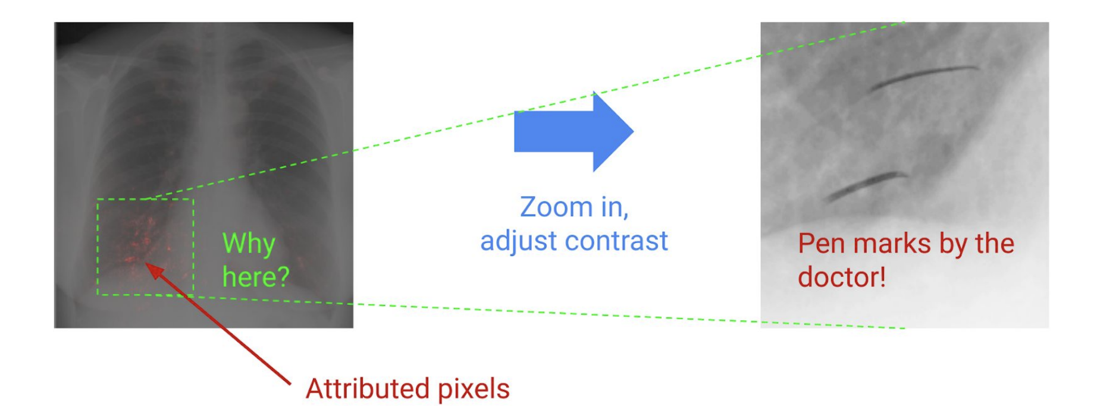
Explainability, Monitoring in AI Democratization
Auditing predictions for unlikely classes
Monitoring the model to ensure it's operating correctly
Feature attributions (monitor attribution skew ) bringing Explainability along several dimensions
Analysis of influential features having skew rather than features that are generally less influential
Image pathology model trained to detect various diseases from chest X-Ray scans, exhibits pen marks by radiologist
Source : https://storage.googleapis.com/cloud-ai-whitepapers/AI%20Explainability%20Whitepaper.pdf

Slide 17
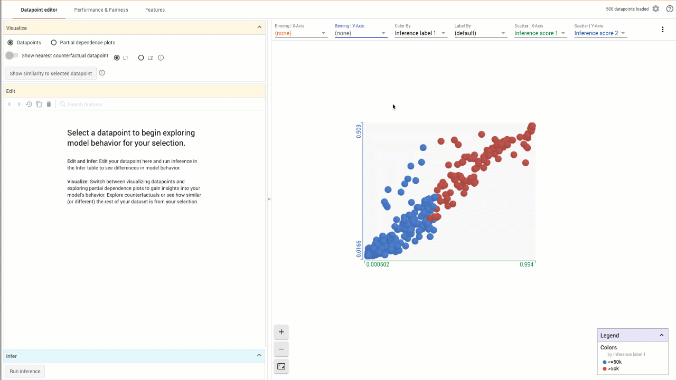
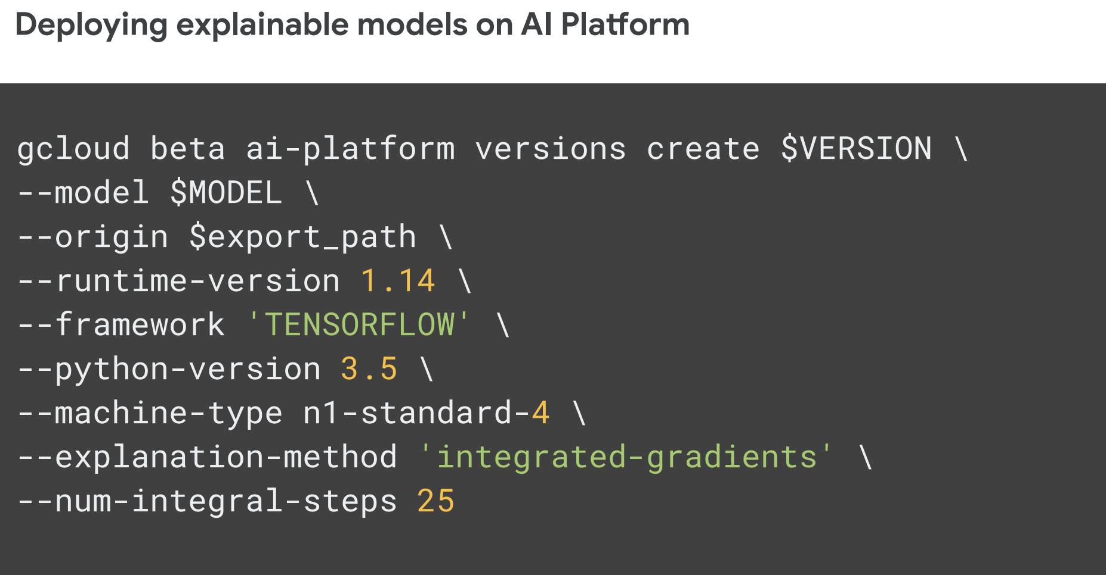
Fairness - An essential component of AI Democratization
Explainable AI- To better understand business, explaining of model features is a prerequisite Explainable AI is available exclusively on AI Platform.
What-if tool- Visualize datasets and better understand the output of models deployed on the platform
Continuous Evaluation- Obtain model performance metrics based on ground-truth labelling of requests. Evaluation and retraining to improve the model based on performance over time.

Slide 18
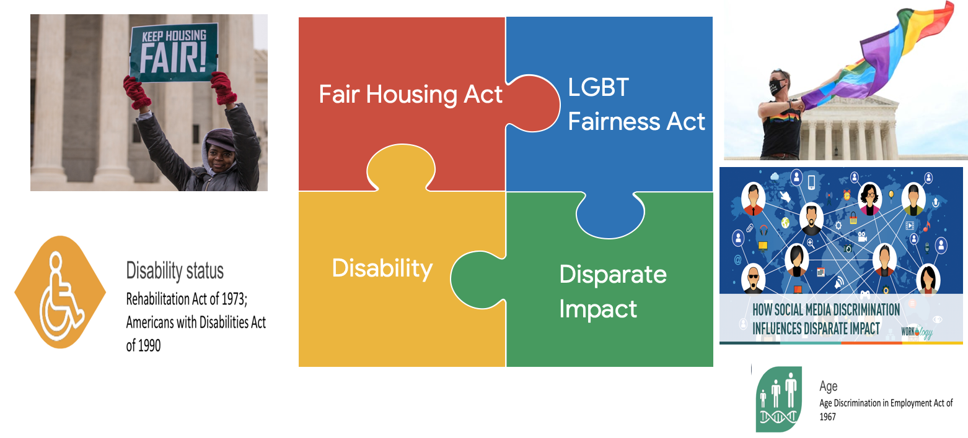
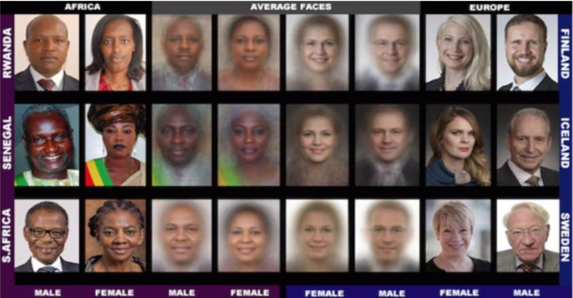
Why Fairness in AI/ML Democratization
Higher accuracy for light-skinned people
Error rates for dark skinned women: 20% - 34%
Source - http://proceedings.mlr.press/v81/buolamwini18a/buolamwini18a.pdf

Slide 19
Case Study in AI Democratization

Slide 20
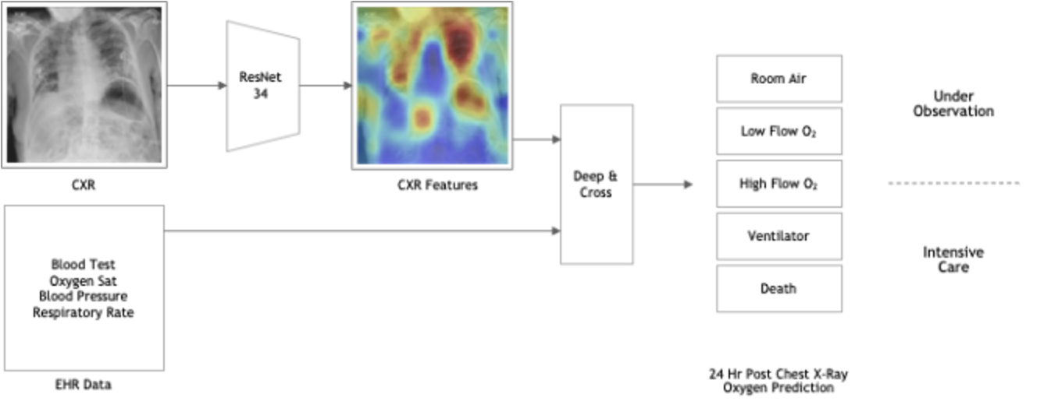
Key Features for AI Democratization with an Use-case
Cost Reduction
Efficient Management of wait time
Removing bias and adding explainability (e.h. Skewed towards white males)
Incorporate Efficiency and Accuracy
Making the solution equitable downstream
Predicting a person in an emergency room with COVID-19 symptoms will need supplemental oxygen hours or even days after an initial exam
Combination of medical imaging and health records.
20 Hospitals across the world in 20 days used distributed data from a multinational diverse datasets of patients across North and South America, Canada, Europe and Asia.
Source : https://blogs.nvidia.com/blog/2020/10/05/federated-learning-covid-oxygen-needs/

Slide 21
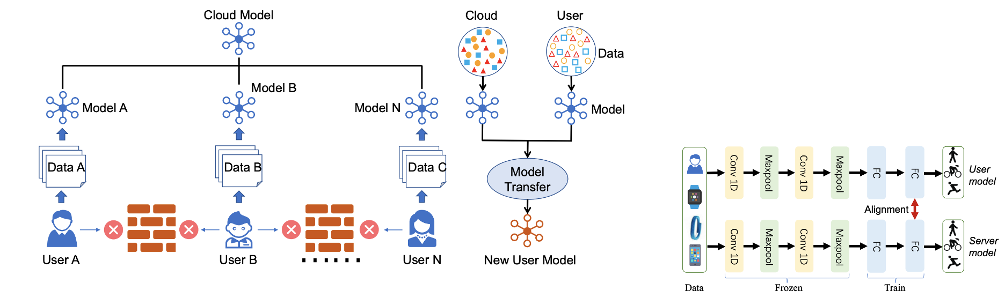
AI Democratization in Healthcare industry
Google Cloud Healthcare Data Protection Toolkit, an automation framework for deploying Google Cloud resources to store and process healthcare data, including protected health information (PHI)
Personalized learning and personalized healthcare
Higher accuracy (5.3% improvement) for wearable activity recognition
Data aggregation from different organizations without compromising privacy security and achieves personalized model learning through knowledge transfer.
Source : FedHealth: A Federated Transfer Learning Framework for Wearable Healthcare https://arxiv.org/pdf/1907.09173.pdf

Slide 22
Sustainability in AI Democratization

Slide 23
Focus on cleaner environments and sustainable AI solutions
GCP Operating the cleanest cloud in the industry
Use less energy
Take advantage of AI-optimized, efficient data centers and better utilization.
Zero net emissions
Meet your public sustainability commitements and reduce the environmental impact of IT operations.
Carbon-free energy by 2030
First company to set the goal to completely decarbonize electricity
Google has neutralized all legacy emissions since 1998 and matched 100% of electricity use with renewable energy since 2017, including the electricity that powers your workloads.
By 2030, we aim to run on 24/7 carbon-free energy at all our data centers, around the clock.
Google data centers are twice as energy efficient than average and compared to 5 years ago we deliver 7x the compute power for the same amount of electricity.
Source : Google

Slide 24
Key considerations when incorporating carbon into IT decisions
1
2
3
4
5
Evaluate a net carbon neutral option for infra and apps.
Estimate what the net carbon emissions impact would be from migration
Architect your app to use cleaner infrastructure options
Report on the gross emissions of your cloud carbon footprint
Optimize your application for reduced gross carbon emissions.
Google’s carbon neutrality is documented in Google's environmental report, where we get our carbon accounting certified by a third party
We can automatically inventory existing infrastructure and provide you with a potential emissions improvement from moving to GCP
You can view a list of GCP regions by their carbon-free energy consumption and choose cleaner regions. Additionally you can set org policies to restrict resource locations to clean regions.
Until we achieve around the clock clean energy, there are gross emissions from running your application in our cloud. We offset them for you, but we’re working on providing you a report.
We’re thinking about features that will help you reduce your footprint over time.
Available today
H2 2021
Future possibilities

Slide 25
Cost and carbon benefits
Choose Finland not Frankfurt
Reduce price for GCE n-1 standard by 14.5%
Increase CFE by 16%
Choose Finland not London
Reduce price by 14.5%
Increase CFE by 23%
Choose Iowa not Northern Virginia
Reduce price by 11%
Increase CFE by 37%
Choose Oregon not LA
Reduce price by 16.8%
Increase CFE by 34%

Slide 26
Where to run Deep learning models?
Run batch jobs on the low carbon option
Batch workloads often have the benefit of planning. You can pick the region with the highest CFE % available to you.
Set an organizational policy for lower carbon regions
You can restrict the location of your resources to a particular Google Cloud region or subset of regions using org policies. Applying a “GCP eco-mode.”
Pick a lower-carbon region for your new applications
If you are going to run an application over time, run in the region with the highest CFE % to lower your gross carbon emissions.
*** Don’t forget efficiency wins like rightsizing, getting rid of idle time and using serverless products that scale on demand.

Slide 27
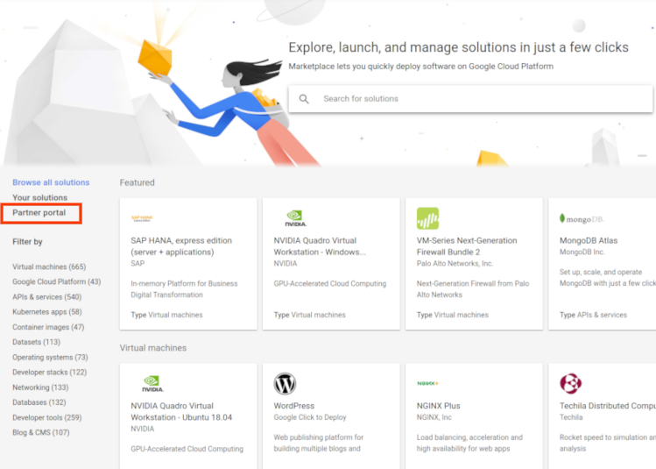

Concluding Thoughts - Role of Google
“Just like cloud computing ushered in the current explosion in startups … machine learning platforms will likely power the next generation of consumer and business tools.”
Specialized Chipsets
Highly scalable Computing Platforms
Open-source deep learning software platforms
Developer Friendly Tools
Marketplaces for ML algorithms and datasets
Source : https://knowledge.wharton.upenn.edu/article/democratization-ai-means-tech-innovation/, Google

Slide 28
Code Samples
Fairness
https://github.com/sharmi1206/fairness-tensorflow-toxicity-classification
https://github.com/sharmi1206/fairness-india-hiring
TensorBoard https://colab.research.google.com/github/tensorflow/tensorboard/blob/master/docs/scalars_and_keras.ipynb#scrollTo=97T4vT3QkQJH
AdaNet
https://techairesearch.com/modeling-banks-churn-rate-with-adanet-a-scalable-flexible-auto-ensemble-learning-framework/

Slide 29
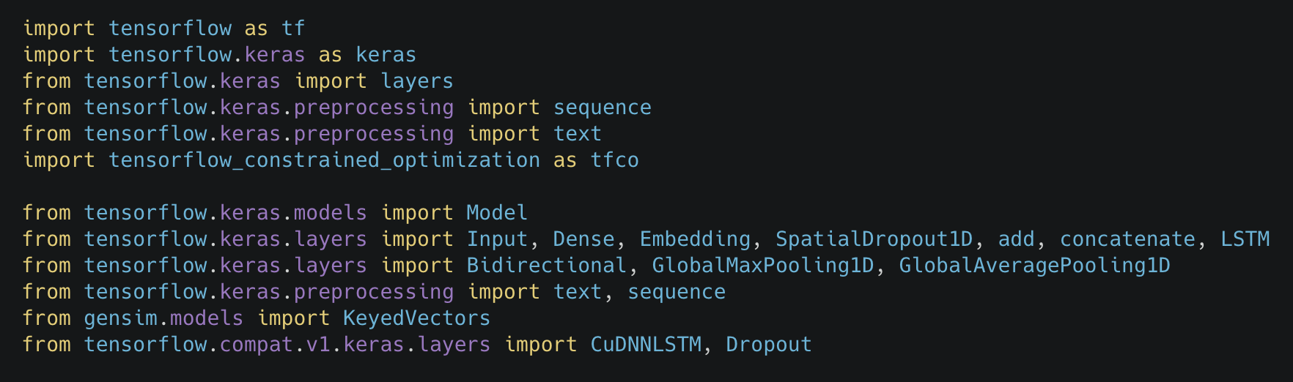
Fairness - An essential component of AI Democratization
Dataset - Jigsaw Unintended Bias in Toxicity Classification
Training, Validation and Test Data set - 902437, 451218, 451218
Identify small proportion of Sensitive Topics using Fairer Models
Sensitive topics related to gender, sexuality, religion, race, mental health, physical health and economic condition
ProxyLagrangianOptimizer with
Constraints on False Positives
Constraints on False Positives and False Negatives
Non-convex and Non-Differentiable Constraints

Slide 30
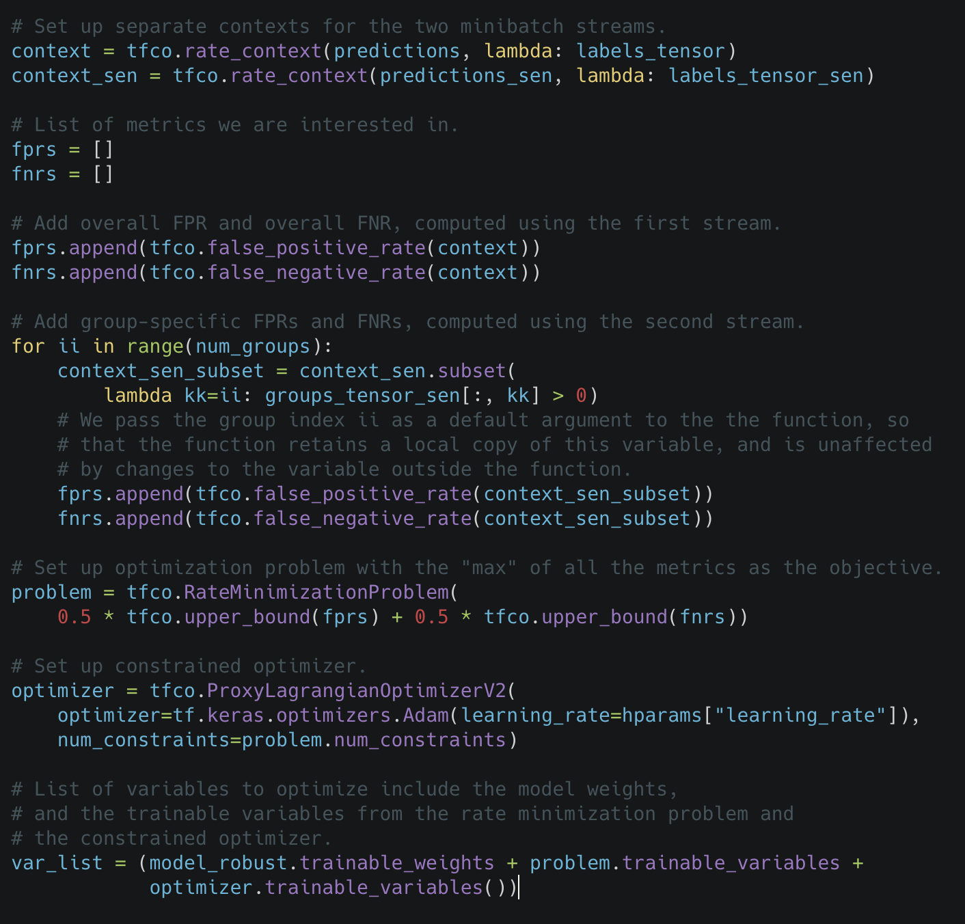
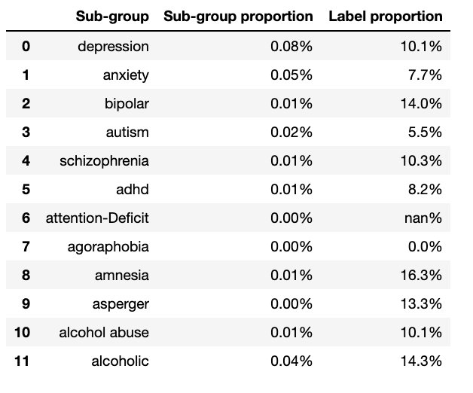
Tensorflow Constrained Optimization
Robust Optimization
Different Types of mental health conditions

Slide 31
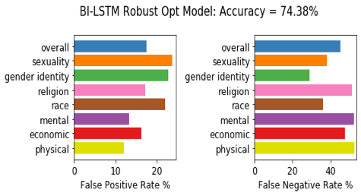
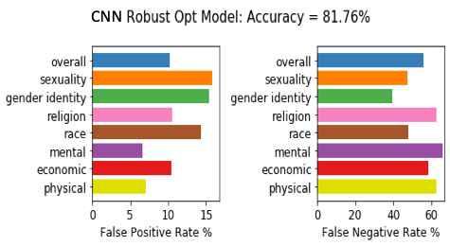
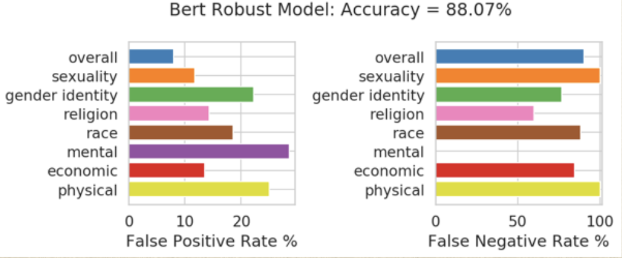
Comparative Study with Robust Optimization

Slide 32
Thank You
Questions

Slide 33
What are the common challenges in creating ML pipelines having Ethics and Sustainability in mind ?
Are there any frameworks for testing hybrid models with accuracy and other ethical AI metrics ?

